Slide 1

How do Ammonium transporters work?
(transport NH₄⁺ or NH₃?)
– Teresa Dias –

Slide 2
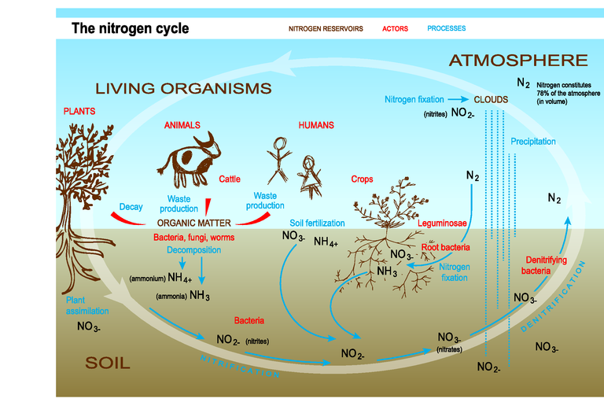
What is NH₄⁺ / NH₃? The N cycle

Slide 3
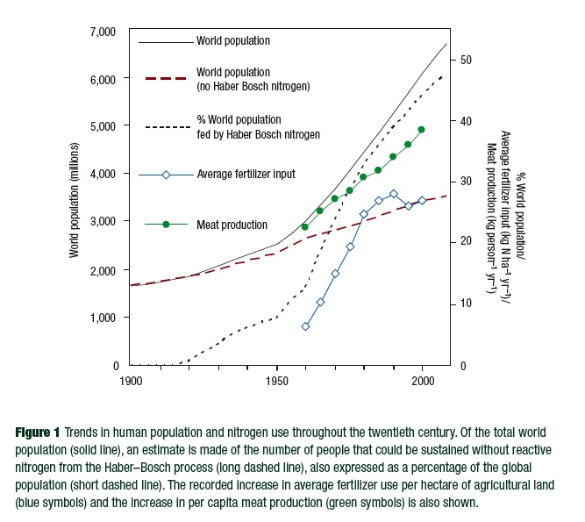
N as an essential nutrient

Slide 4
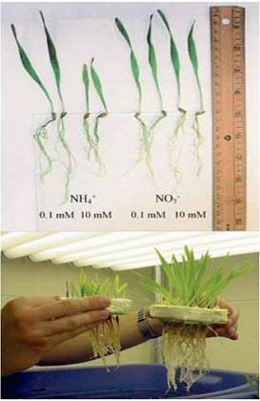
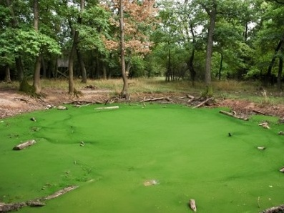
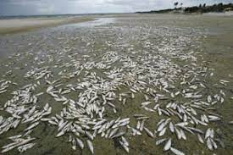
Ammonium toxicity is universal
… and in microorganisms (e.g., bacteria, yeast)

Slide 5
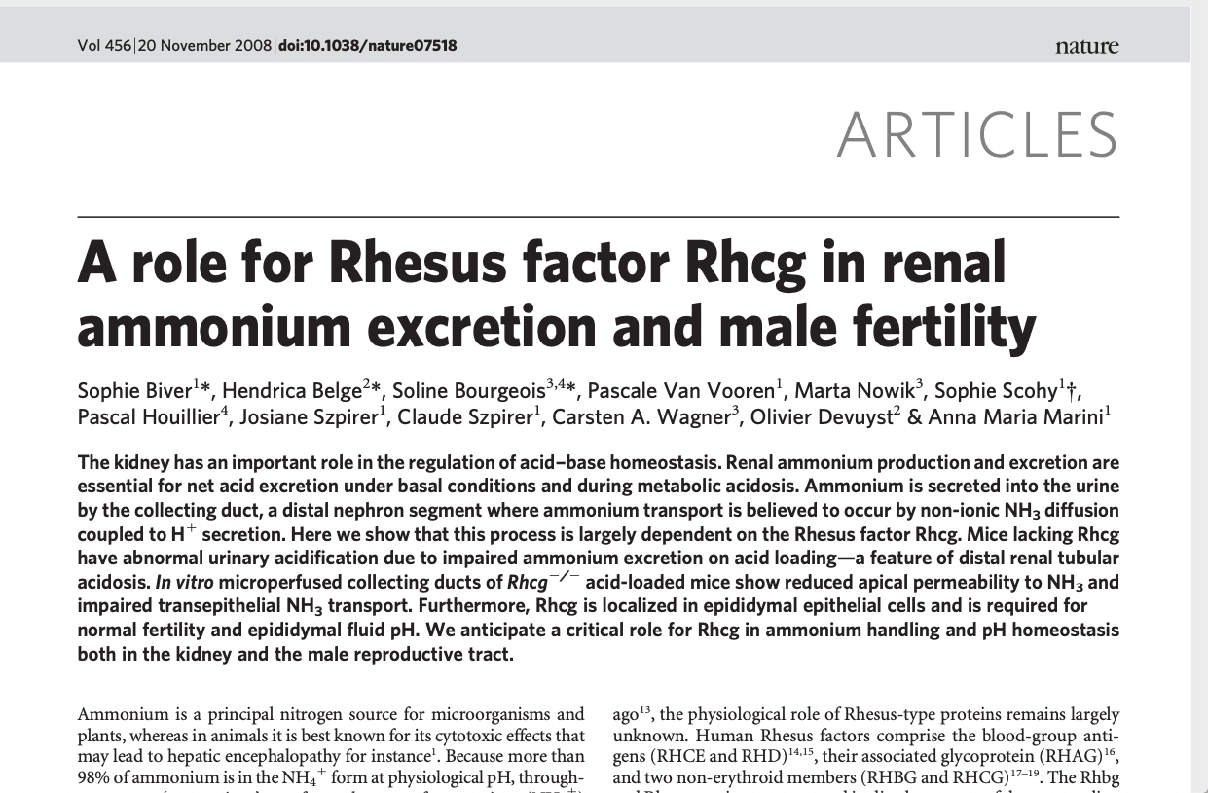

Slide 6
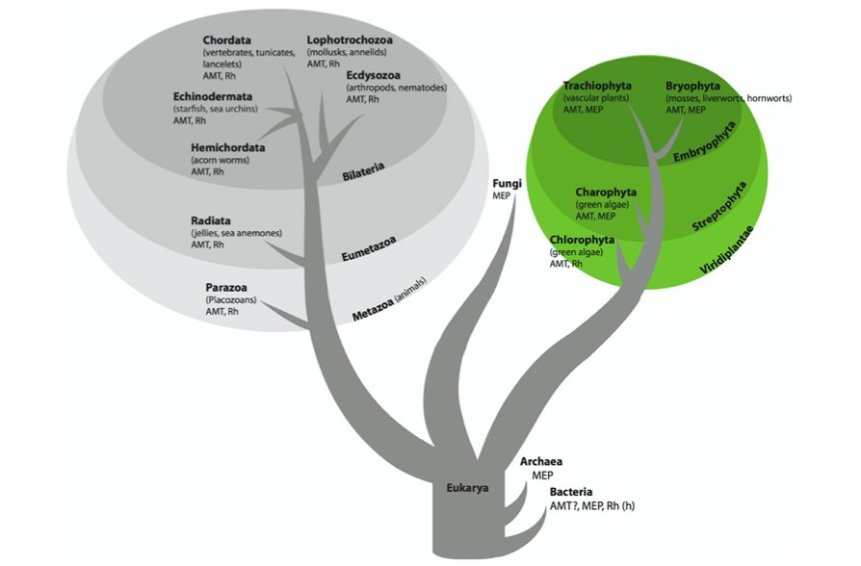
Ammonium transporter family - distribution
Genes in the ammonium transporter family are found in almost all prokaryotic and eukaryotic lineages.
The gene family consists of three major clades, the AMT (ammonium transporters), MEP (methylammonium/ammonium permeases), and Rh (Rhesus) and we refer to the family as the AMT/MEP/Rh family.
Although the AMT/MEP/Rh proteins are structurally similar, their function in:
microorganisms and plants is to uptake ammonium/ammonia, which for these organisms is an important nutrient used in the synthesis of N-containing metabolites such as amino acids
animals is to excrete ammonium/ammonia, a by-product which is toxic to animal cells
McDonald and Ward 2016

Slide 7
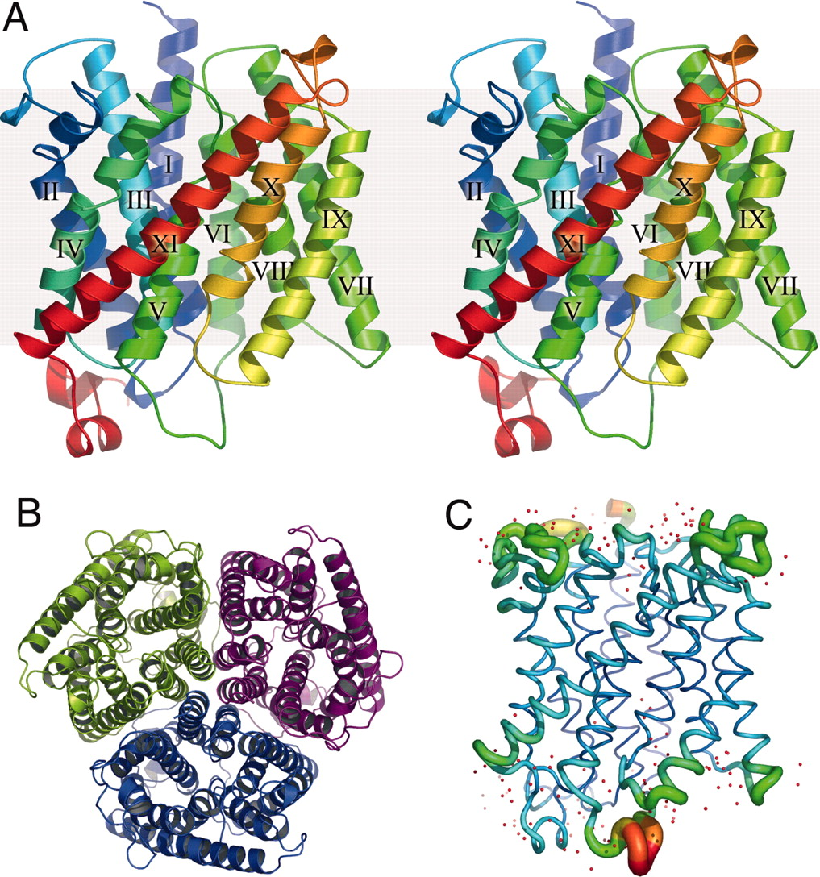
Ammonium transporter family - structure
The structures of AMT/MEP/Rh proteins have been elucidated
(e.g., Escherichia coli and Archaeoglobus fulgidus indicate that these proteins have 11 transmembrane domains that fold into a pore; Rh proteins have demonstrated that these proteins have 12 transmembrane domains and likewise trimerize in the membrane to form a triple pore)
BUT
the transport mechanism and the substrate (NH₄⁺ or NH₃) of these proteins remain hotly debated topics
Crystal structure of Archaea MEP transporters

Slide 8
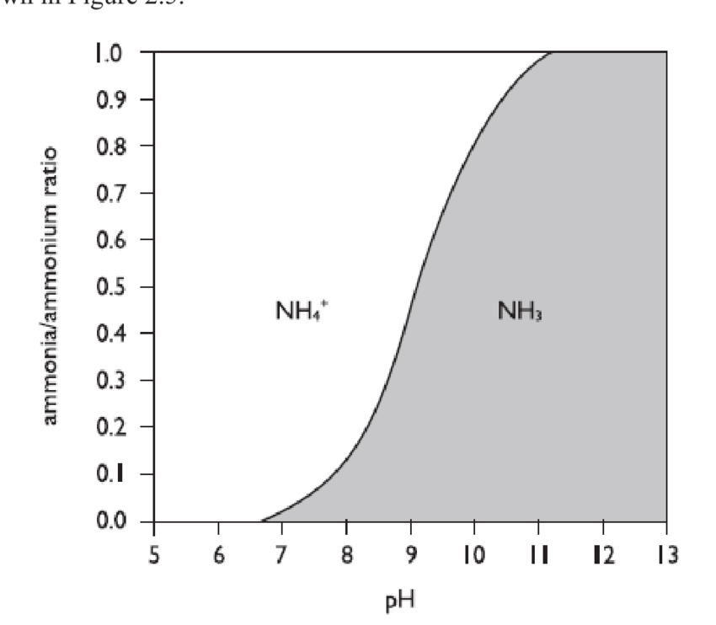
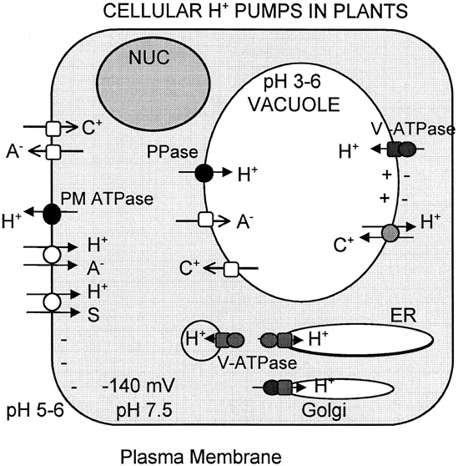
What is the difference between NH₄⁺ and NH₃?
Conversion of NH₄⁺ to NH₃ depends on pH and temperature, with a pKa (where Ka is the acid dissociation constant) ≈ 9.25 at 25°C (pKa ≈ 9.09 at 30°C); at pH <7, more than 99% is NH₄⁺
Sze et al 1999

Slide 9
Ammonium transporter family – HOW DOES IT WORK? What is transported?
At least three distinct transport mechanisms have been reported for proteins in the AMT/MEP/RH family.
MEP
AmtB from E. coli and Amt1 from the archaean A. fulgidus are both found in the MEP clade. Crystal structures indicate that these proteins carry NH₃ through the pore. An ammonium ion docks in an extracellular vestibule, the proton is stripped, the ammonia molecule transverses the pore, and the molecule is reprotonated on the intracellular side. As no charge is transported across the membrane, this transport is electroneutral.
Rh proteins
are generally understood to be passive channels transporting either CO₂ or NH₃, or perhaps both. From the crystal structure of the Rh from Nitrosomonas europaea this protein most likely transports either NH₃ or CO₂. The function of the human RhBG has been studied by radioactive methylammonium uptake and electrophysiology and determined to be electroneutral.

Slide 10
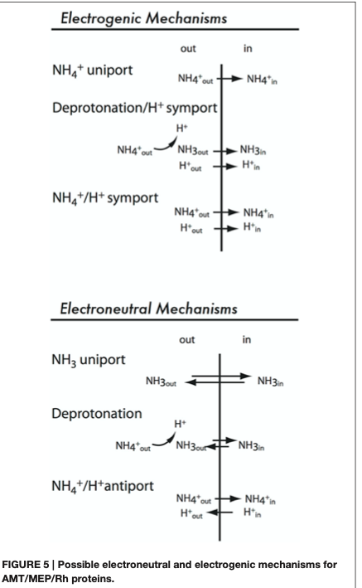
Ammonium transporter family – HOW DOES IT WORK? What is transported?
Some proteins encoded by the AMT/MEP/Rh family
have been demonstrated to facilitate the movement of NH₄⁺ across the membrane, either as NH₄⁺ uniporters or as NH₃/H⁺ co-transporters. Because a net charge crosses the membrane, this type of transport is electrogenic.
It is unclear whether all members of the large AMT/MEP/Rh family translocate NH₃ or whether some translocate NH₄⁺.
McDonald and Ward 2016

Slide 11
High Affinity Transport System (HATS)
[N] from 0 to 0.5-1 mM
MEP, AMT: Km values in μM range
Rh: Km values in mM range
Low Affinity Transport System (LATS)
[N] from 0 to 0.5-1 mM
NSCC (e.g., K+ channels), Aquaporins

Slide 12
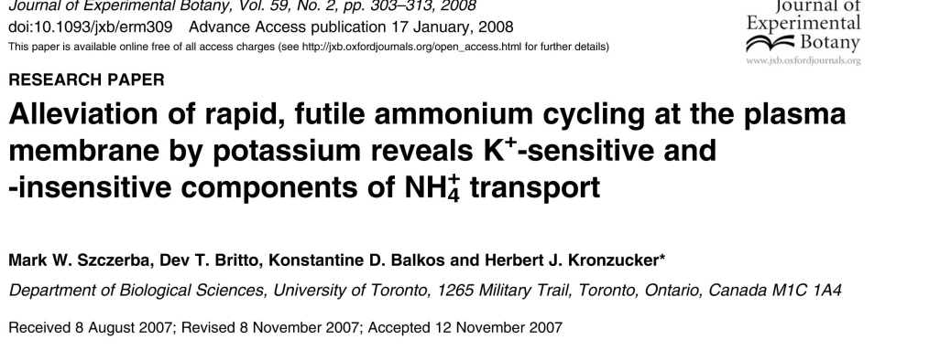
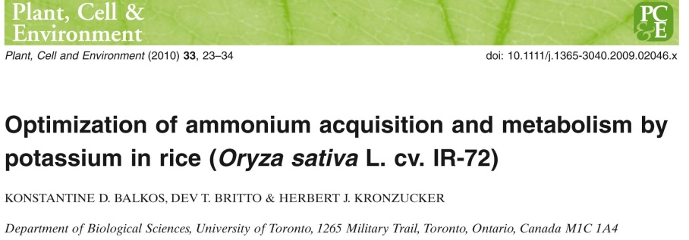
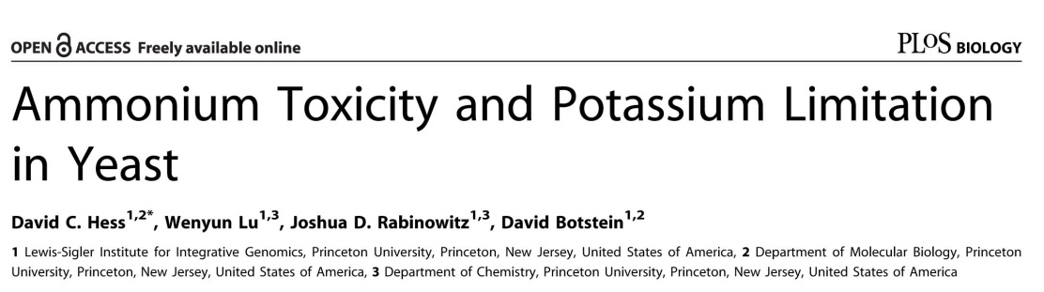
Evidences of K⁺-dependent component of ammonium toxicity (when K⁺ is a limiting nutrient) in:
PLANTS
YEAST

Slide 13
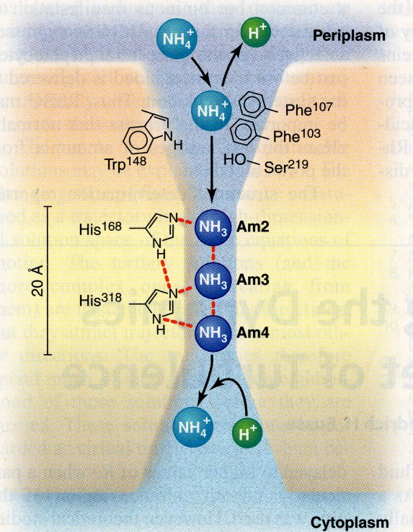
AMMONIUM/AMMONIA LATS 2?
AMMONIUM/AMMONIA LATS 1?
K-dependent/No N discrimination
+
-
+
-
K-independent/ N discrimination
+
-
H⁺
NH₄⁺
NH₄⁺
+
K⁺
-
+
-
A system like that proposed by Khademi et al 2004 and Zheng et al 2004 in HATS of E.coli? AMT2 transport?
Or aquaporins like AQP8 (see Saparov et al 2007. Fast and Selective Ammonia Transport by Aquaporin-8). AQP8 exhibits a preference for neutral NH₃ molecules over water, suggesting a physiological role in maintenance of acid-base equilibrium. In physiological concentrations AQP8 may augment the basal NH₃ conductivity 3- to 5-fold.

Slide 14
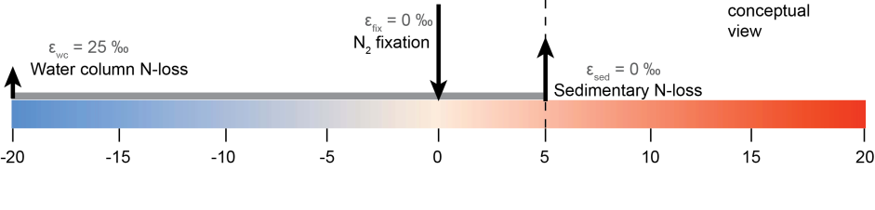
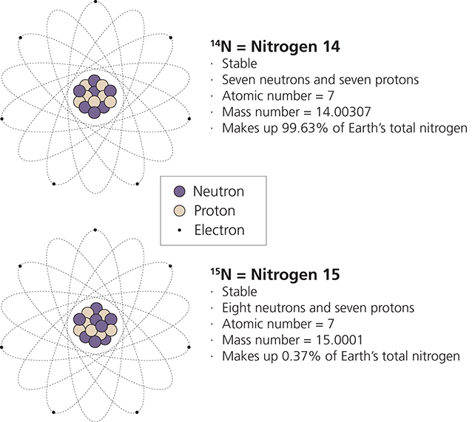
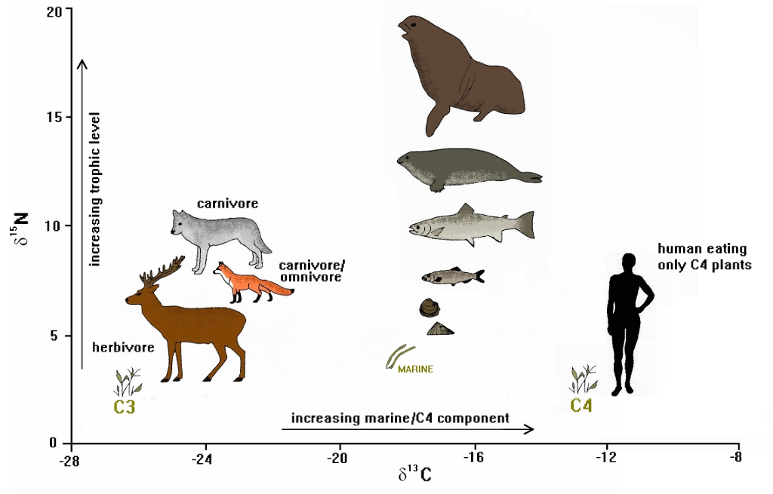
N stable isotopes
NH₄⁺ containing ¹⁴N are more easily deprotonated than those containing ¹⁵N, leading to an isotopic fractionation linked to an isotope effect, at 30°C, of 1.044 between NH₄⁺ and NH₃

Slide 15
Ammonium transporters in yeast (only MEP for HATS)
NH₃
NH₃
NH₃
HATS
MEP 1
MEP 2
MEP 3
NH₄⁺
NH₃
NH₄⁺
YEAST
NH4+
LATS
MEP 2 - Repressed at [NH₄⁺] > 5 mM

Slide 16
Experimental design using yeast
Yeast strains: Wild types (Soil S.cerevisiae and Σ1278b), 3ΔMEP mutants (31019b and 31019b+PFL38_empty vector – no MEP; only LATS is working)
2 K⁺ levels (1.3 and 13 mM)
Increasing NH₄⁺ concentrations (0.5, 1, 5, 20, 76 and 300 mM)
Relationship between uptake of NH₄⁺/NH₃ and δ¹⁵N of organisms

Slide 17
HATS
HATS
Number of yeast colonies indicates the lethal treatments.

Slide 18
Low Potassium (1.3 mM)
High Potassium (13 mM)
1.0
1.0
HATS
WT
WT
3
Δ
3
Δ
0.8
0.8
0.6
0.6
Growth
0.4
0.4
DO 600nm
DO 600nm
0.2
0.2
0.0
0.0
NH₃ transport through MEP cause ¹⁵N depletion of the yeast!
¹⁵ N discrimination
¹⁴N enriched-amino acids excretion
Thus, MEP mutant (3Δ) is not able to discriminate against ¹⁵N during N uptake
NH₃-dependent component is masked by the strong NH₄⁺ - K⁺ competition for K⁺ channels
MEP: Dual affinity transporters!
Valores de δ¹⁵N de las fuentes de N: (NH₄)₂SO₄=0.044; Uracil=-3.1

Slide 19
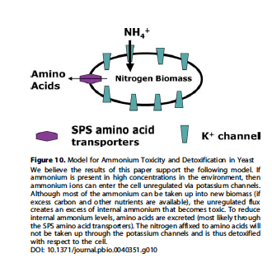
How do yeasts cope with ammonium toxicity?

Slide 20
δ¹⁵N of N source (NH₄)₂SO₄=0.044
NH₃ transport through MEP cause ¹⁵N depletion of the yeast!
¹⁴N enriched-amino acids excretion (see bellow)
Thus, MEP mutant (3Δ) is not able to discriminate against ¹⁵N during N uptake
Σ1278b = wild type for 31019b
WT: is a wild S. cerevisiae isolated from the soil
NH₃-dependent component is masked by the strong NH₄⁺ - K⁺ competition for K⁺ channels
MEP: Dual affinity transporters?
Yes!
Amino acids excretion
Amino acids detection in Σ1278b media is pending (in process)
Now, it would be interesting to know which is the MEP transporter that works under LATS conditions? Could it work at 76mM? at 100mM? and even at 200mM? Interesting strains to test:
31019b+Mep1
31019b+Mep2
31019b+Mep3

Slide 21
There is ¹⁵N discrimination during amino acids excretion which means that most excreted amino acids contain ¹⁴N.
Therefore, yeast cells coping with ammonium toxicity become enriched in the heavier isotope!

Slide 22
The 2 components of NH₄⁺/NH₃ transport
(K dependent and K independent)
Toxicity
K-dependent
Only K channels transport
3ΔMEP under LATS
NH₃-dependent
Only MEP transport
WT under HATS
The natural N abundance is correlated to N percentage.
However this relationship is “positive” or “negative” depending on the main NH₄⁺/Nh₃ transport mechanism is working: K⁺-dependent (no discriminatory) or NH₃-dependent (discriminatory)

Slide 23
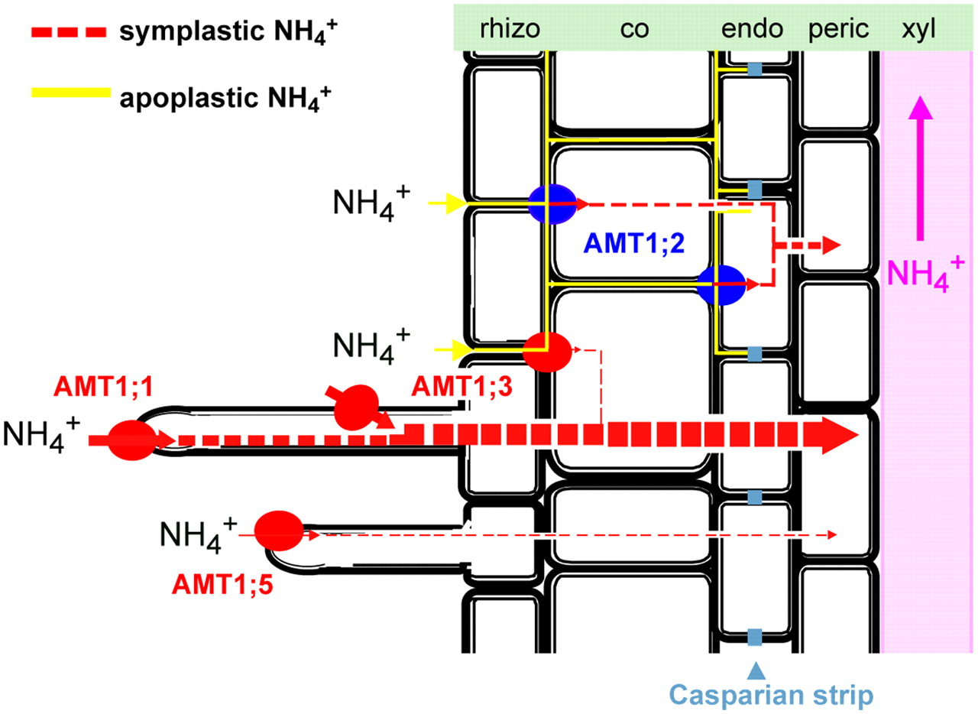
What about in other kingdoms?
Example: Ammonium transporters in plants
Very complex to study in vivo

Slide 24
Using heterologous expression in yeast cells it is possible to study ammonium transporters see Ariz et al 2018
(transport NH₃)

